Slide 1
Maveen
http://www.slideshare.net/ReturnOnIntelligence/apache-maven-2-overview-50709463

Slide 2
MI Data Architecture – Proposed Data Pipeline
Collect data from various DS
Spark
(Streaming +
Micro Batch)
Active MQ
P/C/Bro
Storm
Yarn
Kafka
Kafka – buffer
Distributed MSG system
HDFS (S3)
Message Pack
;;;;;;;;;;;;;;;;;;;;;;;;;;;;;;;;;jhjnb
CID
Asylum Mart
INGEST
DW Load ETL
CRS
Spark+
Native Scripts
BAM Mart
ASYS
Samza Streaming
MI DW Green Plum
Final State Topic
MI Topic
Data Mart
ETLs
Future Mart(s)
IPT
CW
Message Pack
MP to Jason
PCV

Slide 3
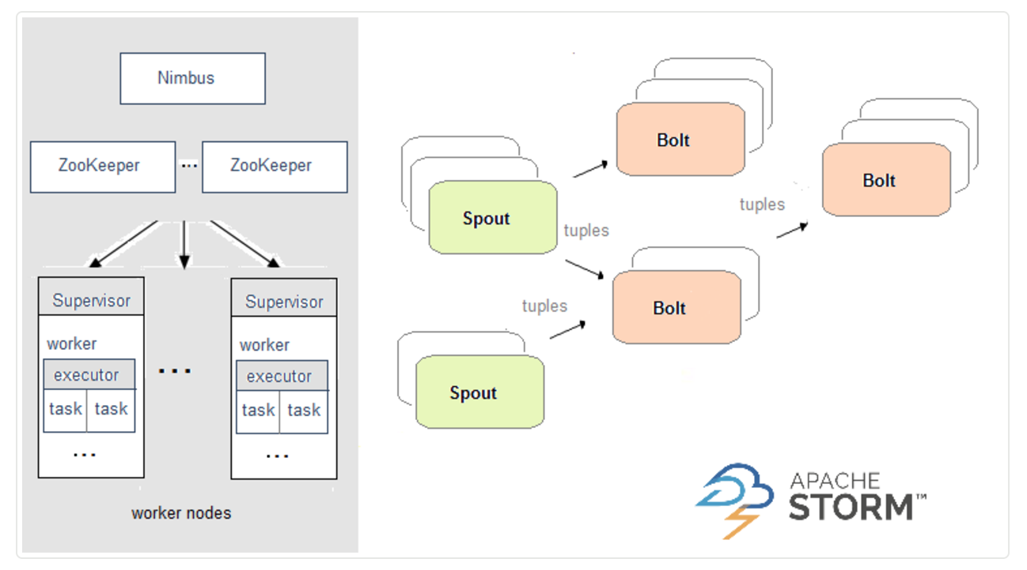

Slide 4
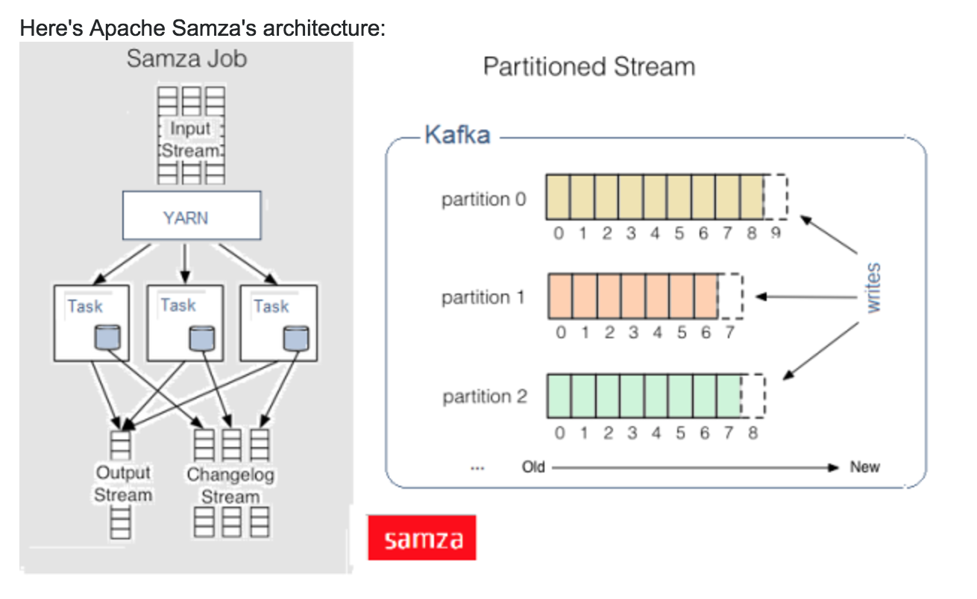
Thank you

Slide 5
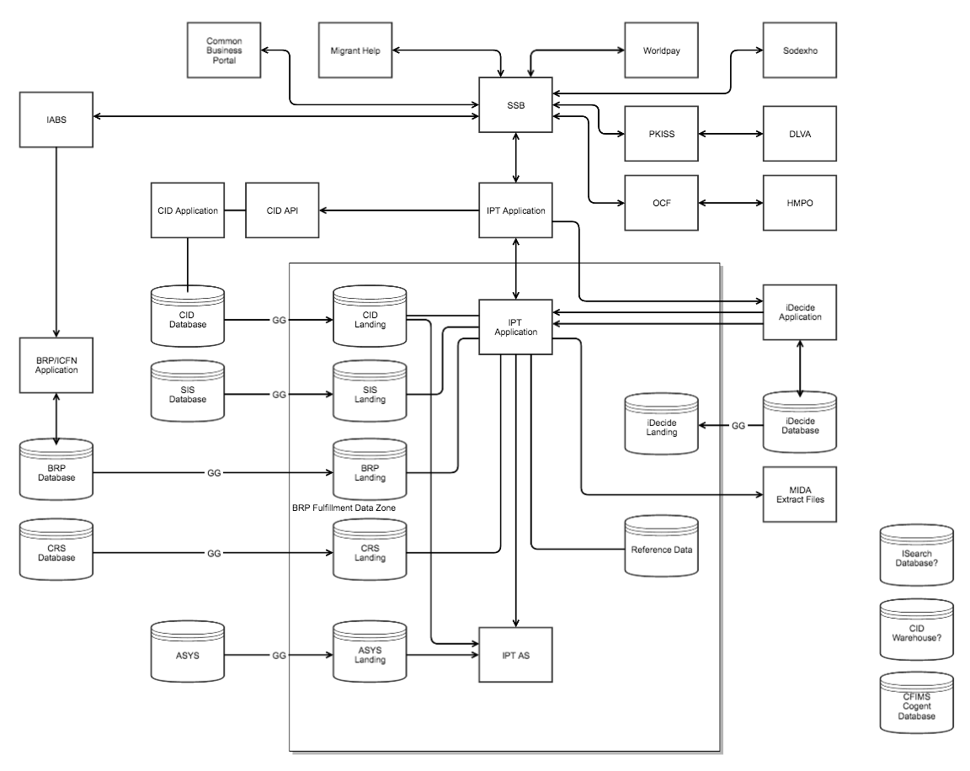

Slide 6
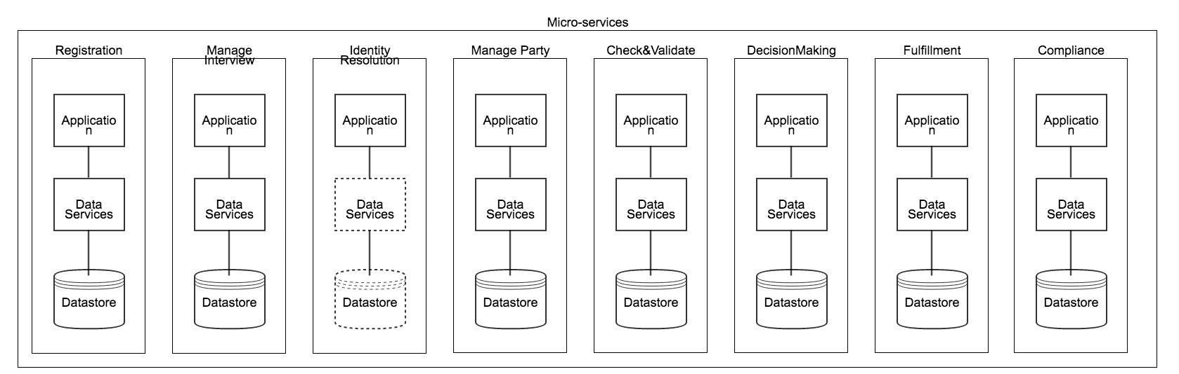
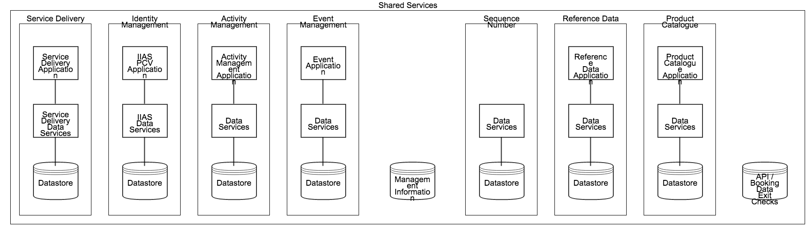

Slide 7
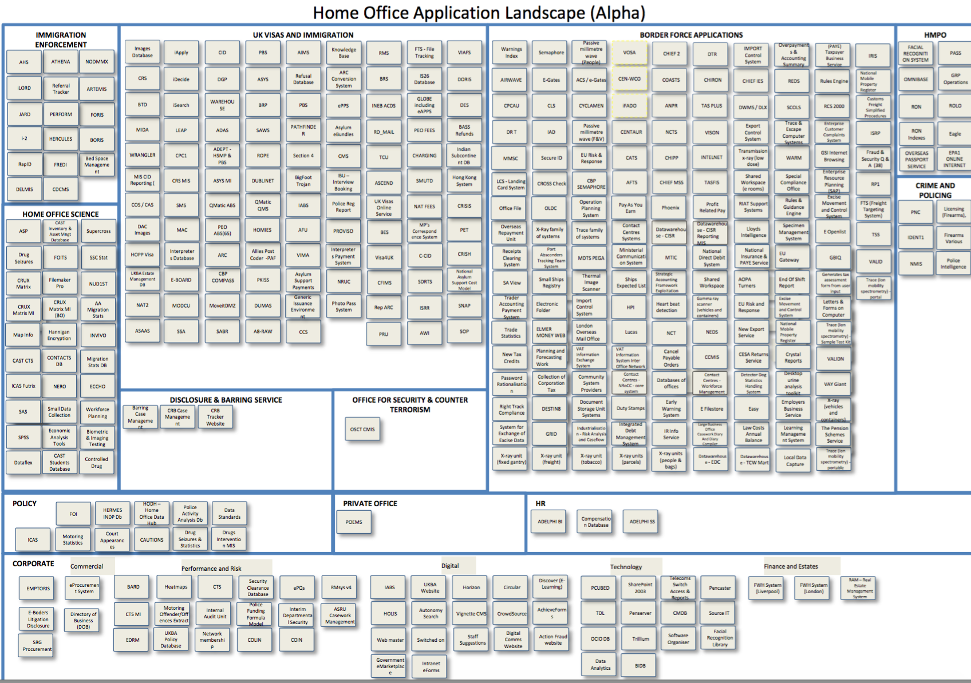

Slide 8
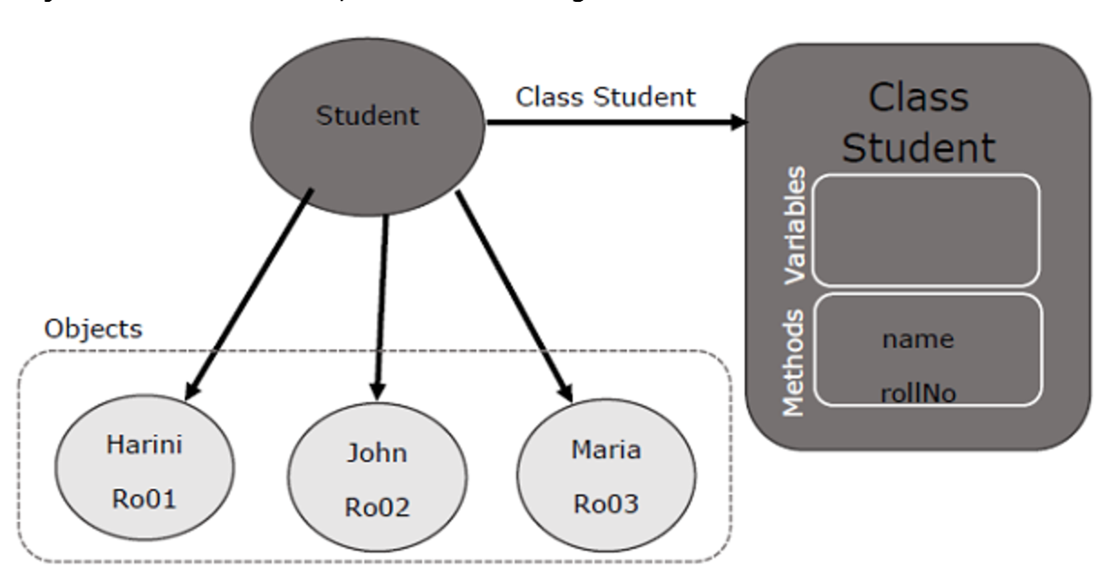
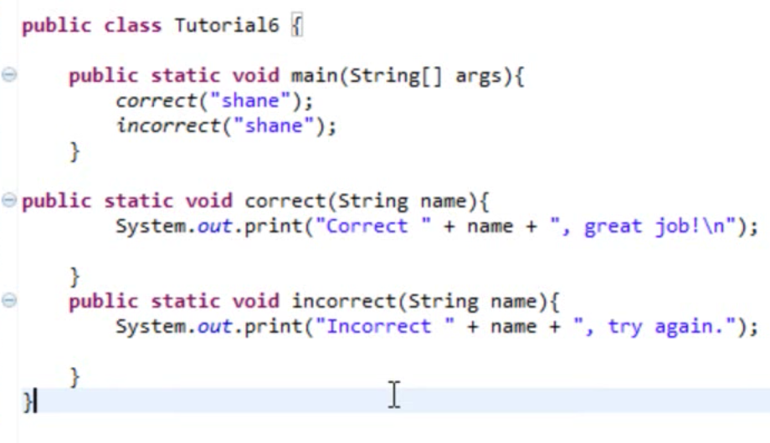

Slide 9
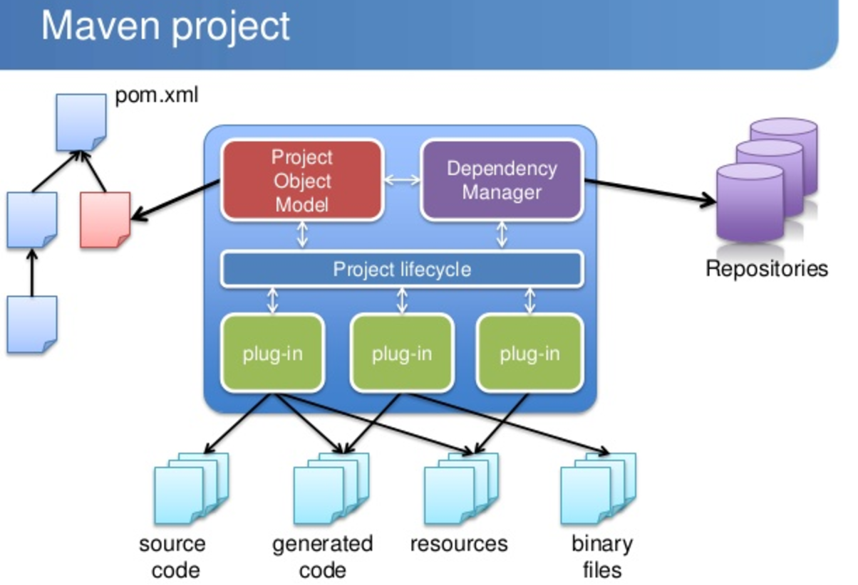
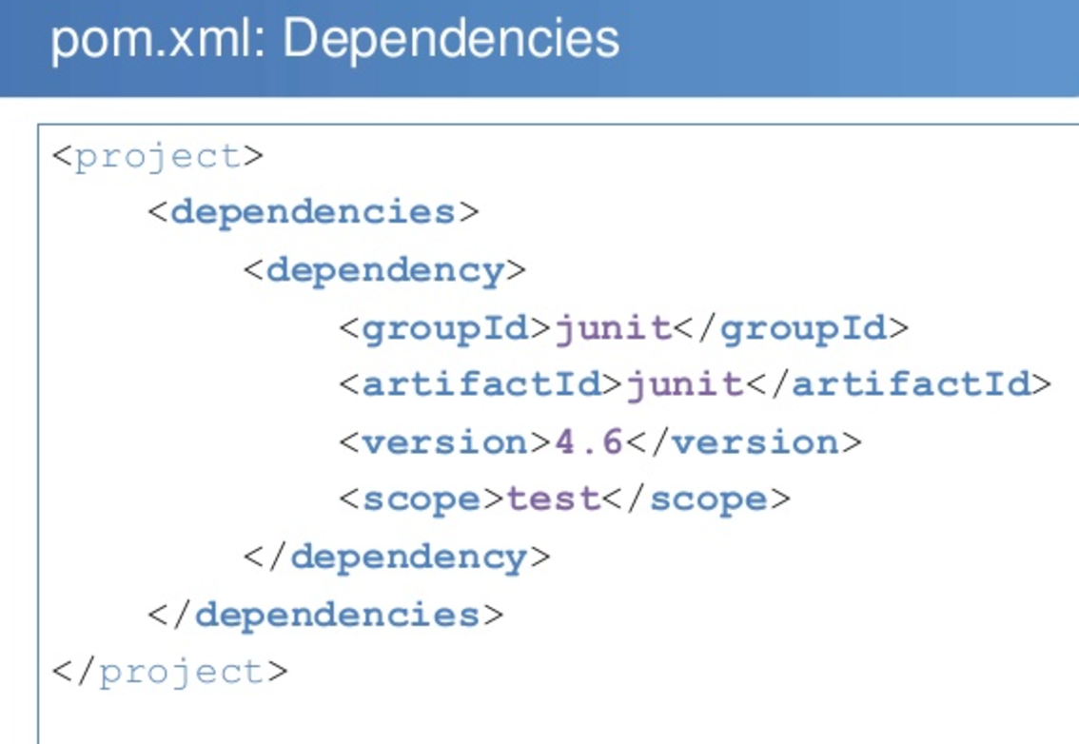
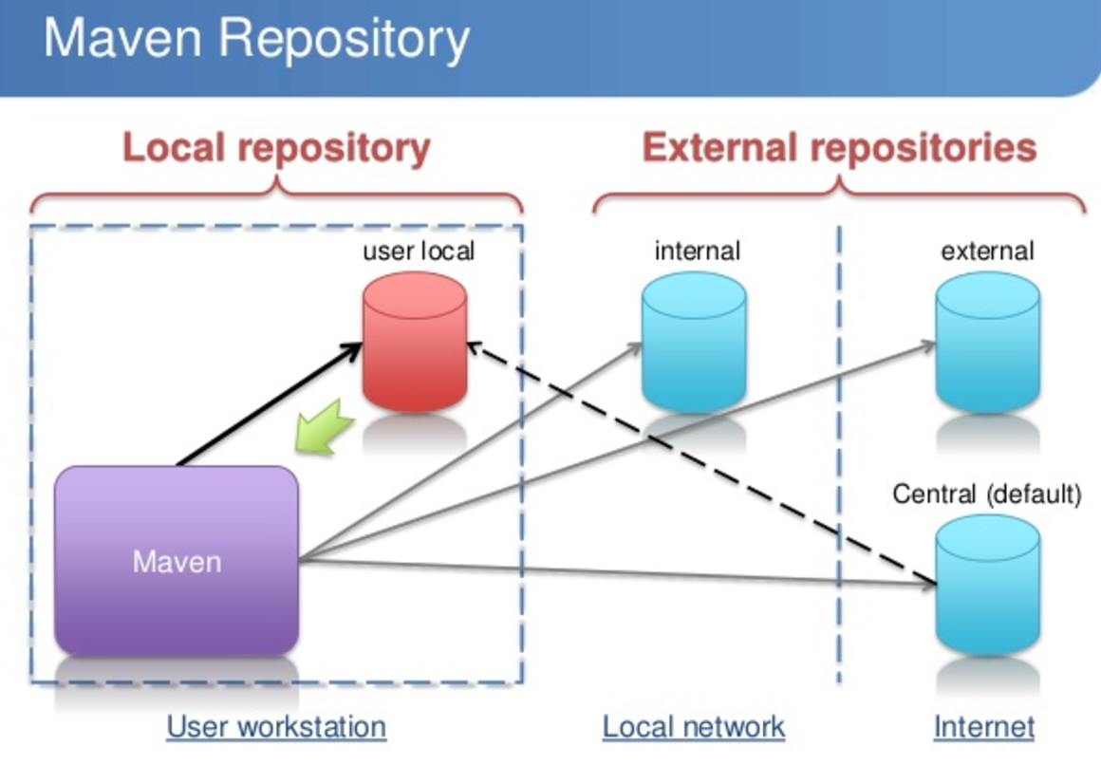
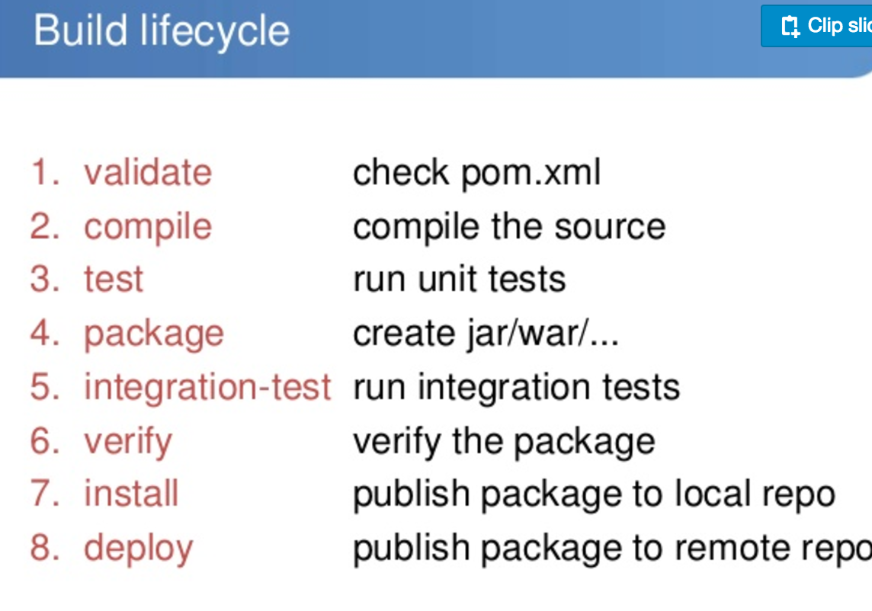
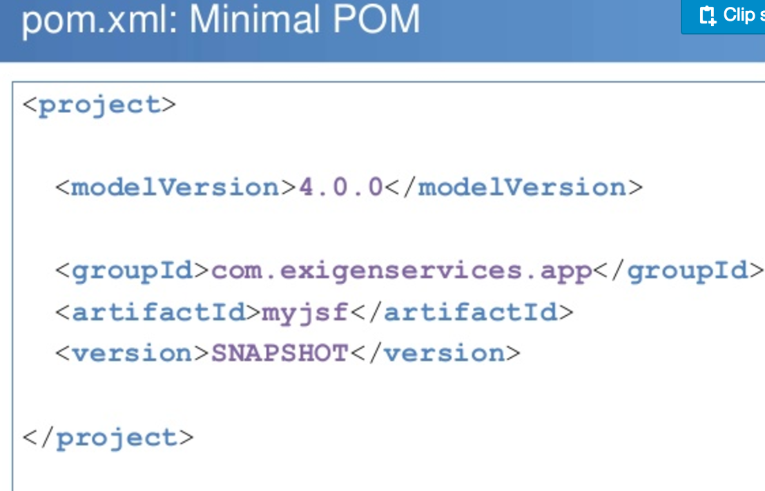

Slide 10
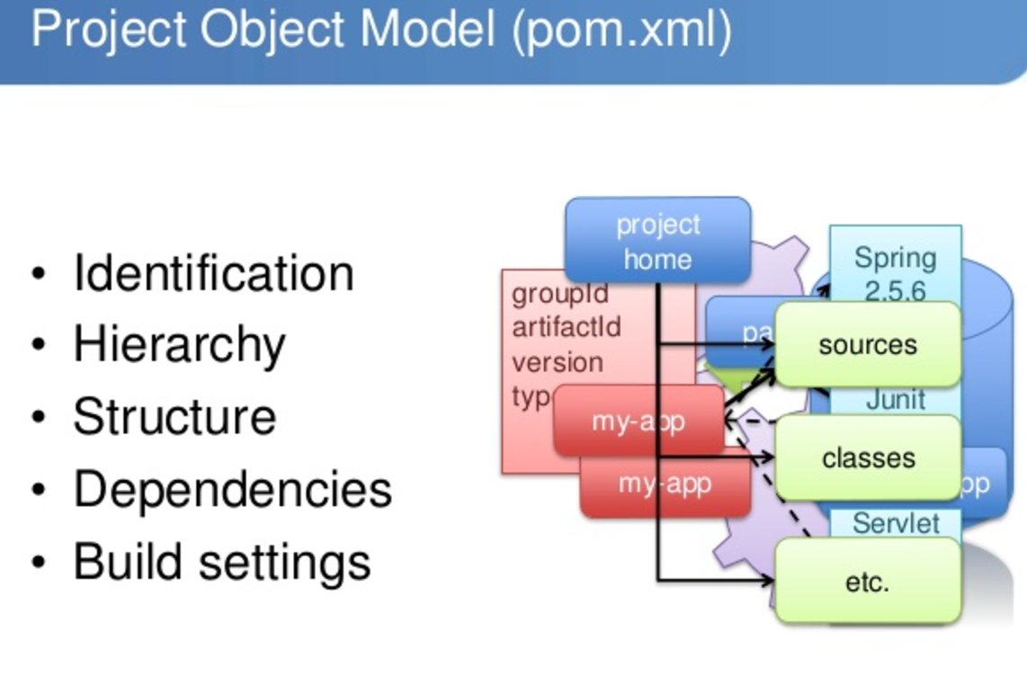
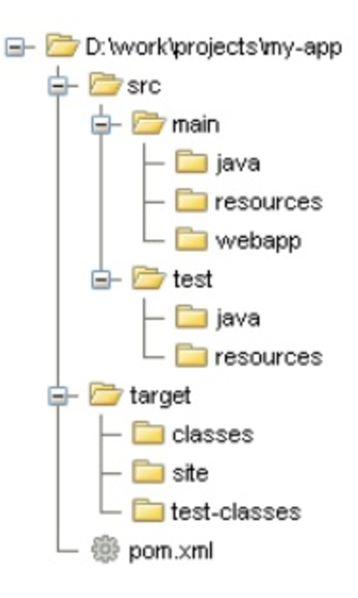

Slide 11
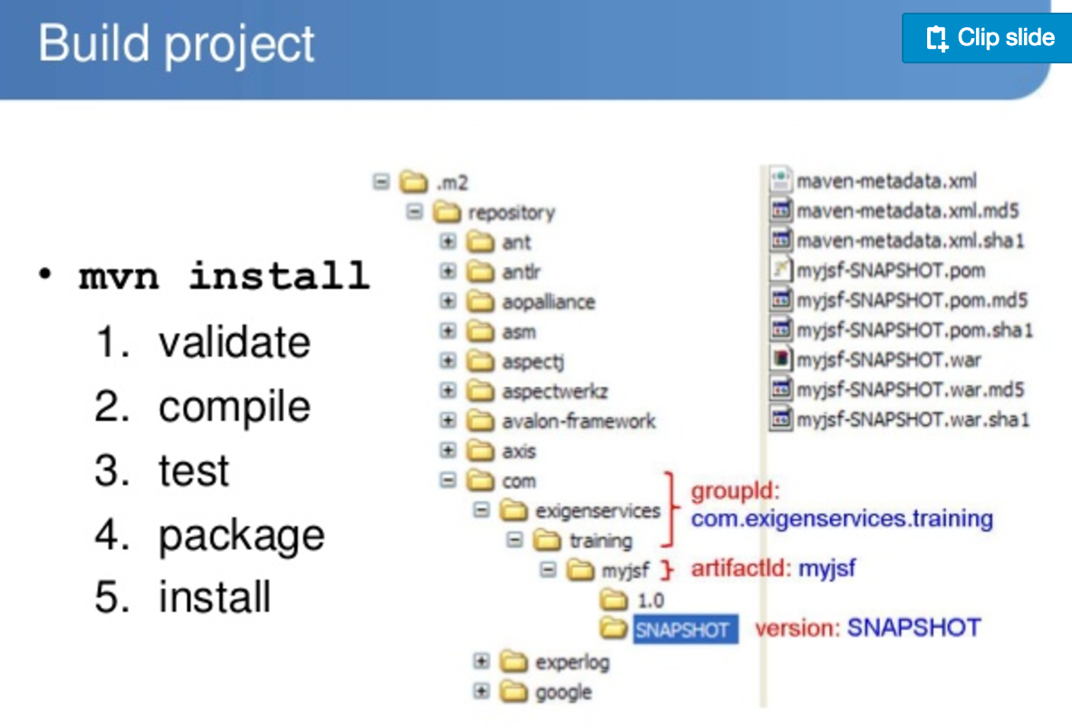

Slide 12
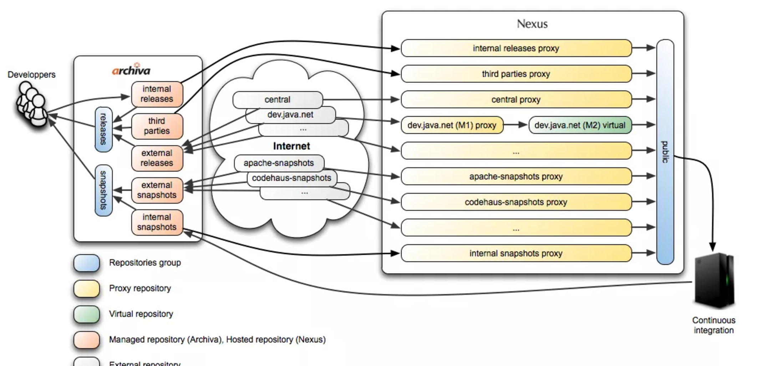

Slide 13
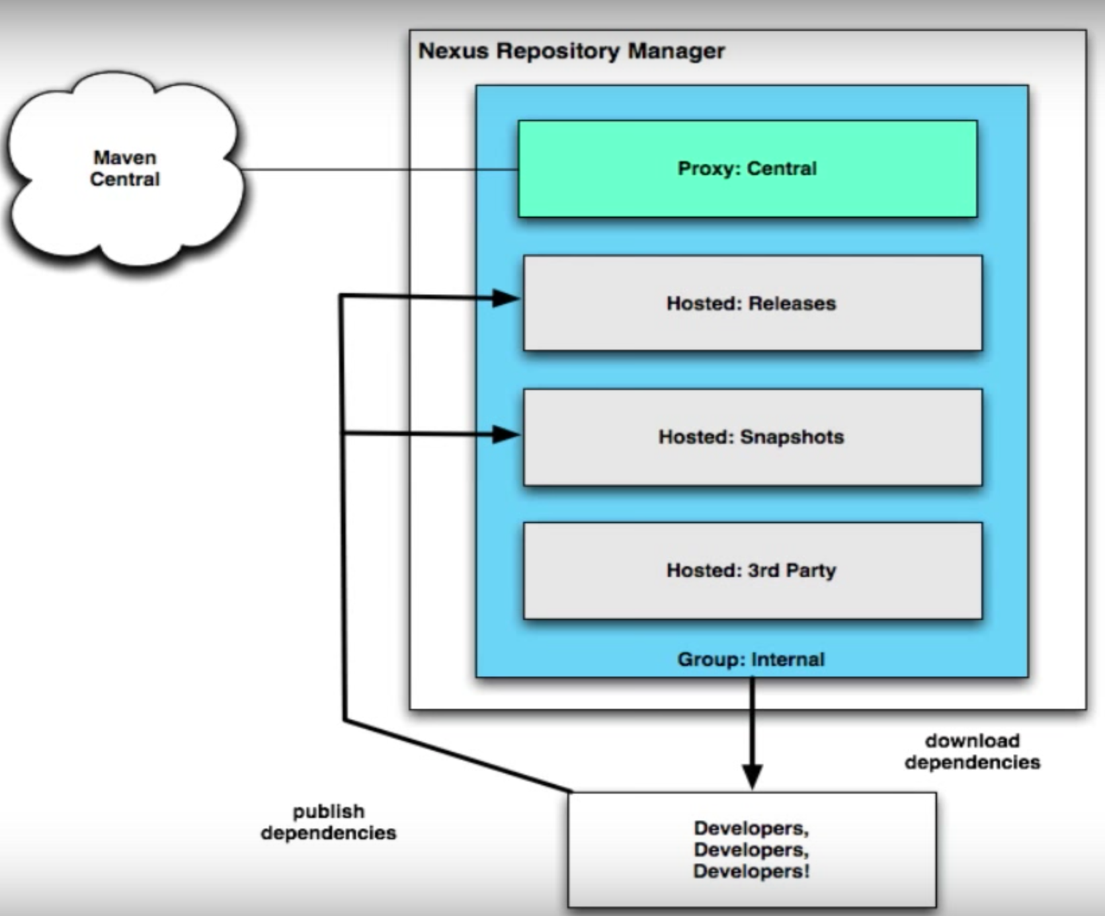

Slide 14
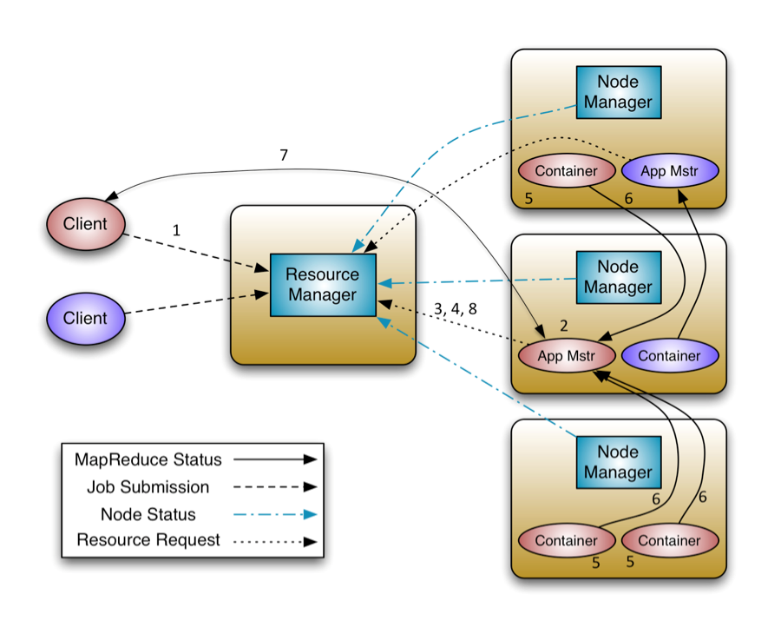
Apache Hadoop YARN. The fundamental idea of YARN is to split up the functionalities of resource management and job scheduling/monitoring into separate daemons. The idea is to have a global ResourceManager (RM) and per-application ApplicationMaster (AM). An application is either a single job or a DAG of jobs.26 Jan 2016
ssh -A naiduj@jump.node.ops.iptho.co.uk
Resource Manager
In YARN, the ResourceManager is, primarily, a pure scheduler.
In essence, it’s strictly limited to arbitrating available resources
in the system among the competing applications – a market maker if you will.
It optimizes for cluster utilization (keep all resources in use all the time)
against various constraints such as capacity guarantees, fairness, and SLAs.
To allow for different policy constraints the ResourceManager has a pluggable scheduler
that allows for different algorithms such as capacity and fair scheduling to be used as
necessary.

Slide 15
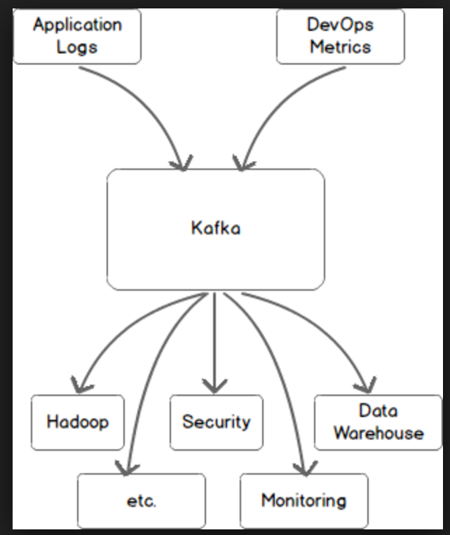
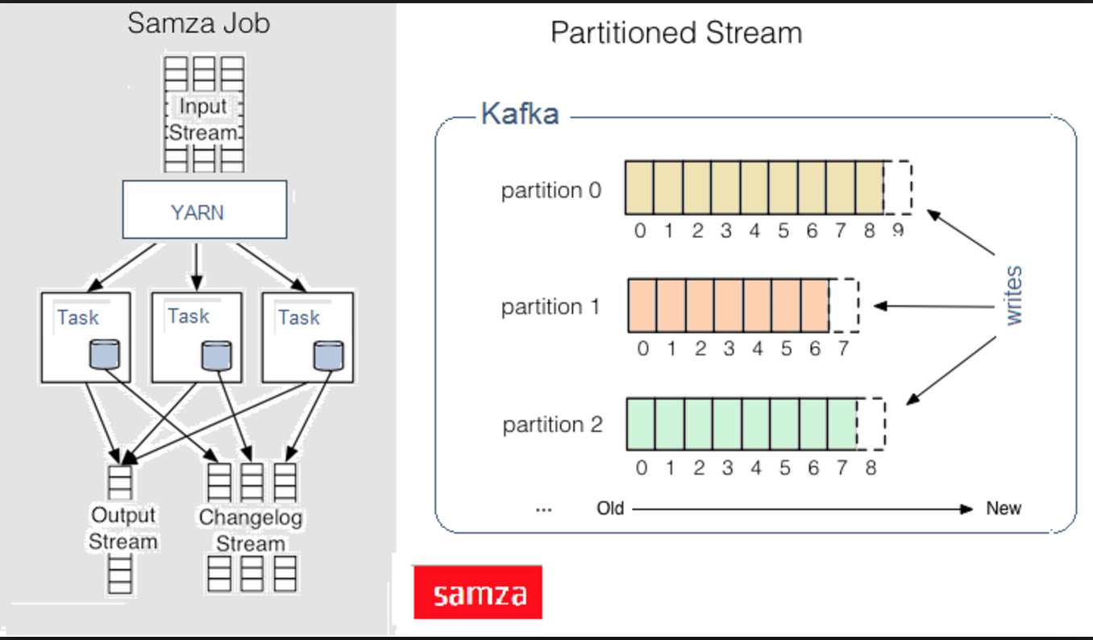
Kafka is a messaging system. That's it.

Slide 16
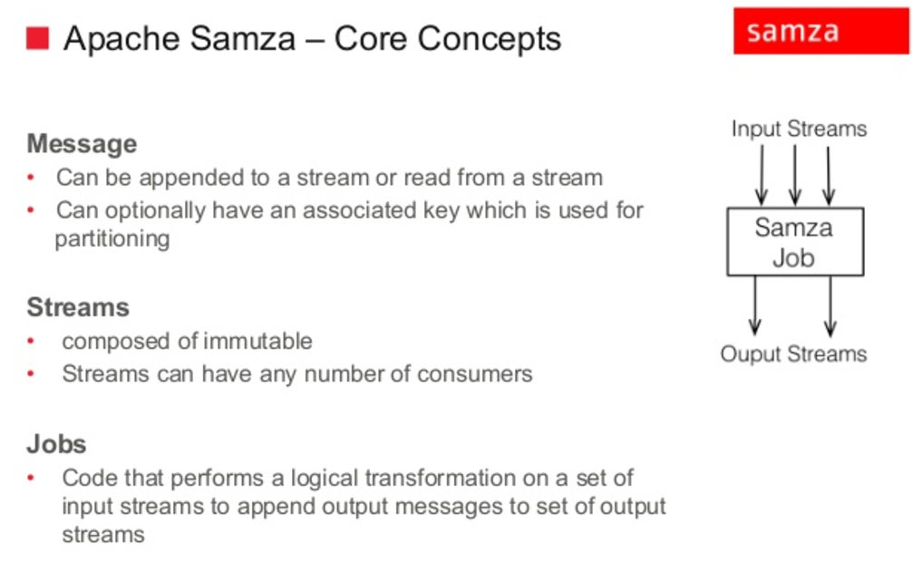
Apache Samza is a distributed stream processing framework. It uses Apache Kafka for messaging, and Apache Hadoop YARN to provide fault tolerance, processor isolation, security, and resource management. ... YARN provides a distributed environment for Samza containers to run in.

Slide 17
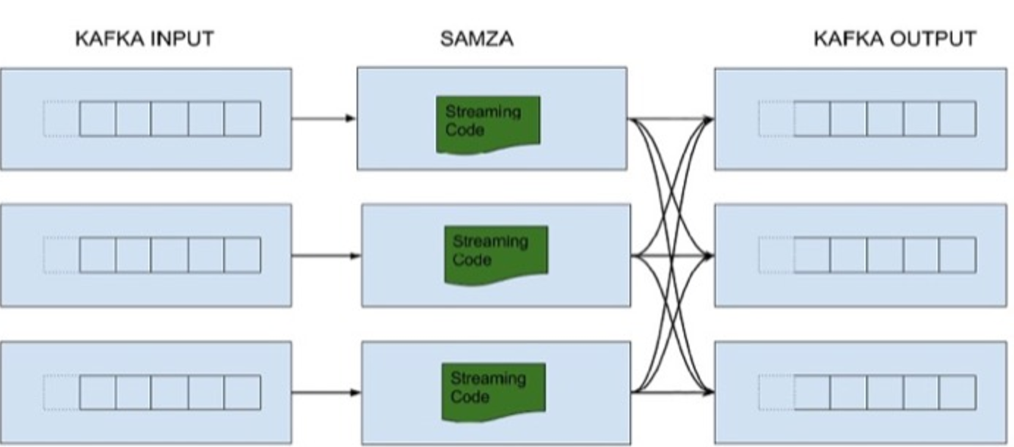
Kafka – Kafka is a messaging system. That's it.
Samza - Apache Samza is a distributed stream processing framework. It uses Apache Kafka for messaging, and Apache Hadoop YARN to provide fault tolerance, processor isolation, security, and resource management. ...
YARN provides a distributed environment for Samza containers to run in.

Slide 18
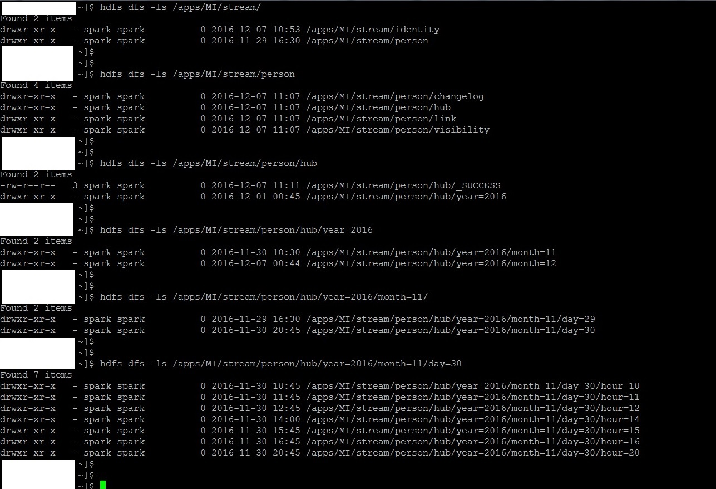

Slide 19
 | File |  | Modified
 | Microsoft Excel Spreadsheet MI_Person_Mapping.xlsx |  | Dec 01, 2016 by Anand Dighe
 | JPEG File MI_Stream_HDFS_Structure.jpg |  | yesterday at 11:42 AM by Anand Dighe
 | Microsoft Excel Spreadsheet MI_Identity_Mapping.xlsx |  | yesterday at 5:20 PM by Anand Dighe
Purpose
This page will document the design on how data in the MI Kafka Topics (JSON format) will be ingested, processed and handed-over to the next phase in the Data Pipeline. It covers the following:
How data will be read from MI Kafka Topics;
How data will be processed in Spark;
How data will be written to a persistent staging data store
Phase Objective
Spark Streaming will be used for this Phase. Under the cover, Spark Streaming executes as a micro batch, where the batch window can be configured (e.g. every 2 seconds).
The main objective of this phase is to:
Ingest the messages (Nested JSON documents) from MI Kafka topics in streaming mode
Convert the nested json structures to flat structures aligned to the target DW data model
Derive Hash values for record keys (Key Hash) and record attributes (Value Hash)
Write the flattened structures to files in HDFS
Phase Logical Steps
Read Step
Data will be read from the following MI Kafka Topics which contain the messages as Nested JSON Documents [Note - The previous phase (Phase 1) has converted data from Kafka Message Pack format and written to Kafka MI in JSON format]
Person
Identity,
Service Delivery
Event
Address
Organisation
Individual
At the end of this step, the data in Kafka (JSON) shall be read into Spark memory structures (RDD/DataFrames)
Process Step
In this step, the nested json structures shall be flattened to align to the target DW data model.
Additionally Hash Values would be derived for the following:
Key Hash = Hash (Record Source + Record Handle ID)
Value Hash = Hash (Record Non-key attributes)
SHA1 algorithm will be used to generate the Hash Values
All of this processing would be done in memory using Spark data structures.
Note: The attachments to this page will provide the detailed mapping rules required for the processing step. E.g. Person Mapping rules are present in MI_Person_Mapping.xlsx
Write Step
In this step, the data from the Processing step will be written to HDFS file
The HDFS files will have a hierarchical structure as
/apps/MI/stream/
<Domain>
<Target Table(s)
Time-period
Here is a snapshot of how the data will look for Person Domain
Summary
At the end of this Phase, the data from MI Kafka would have been processed, hash values derived and written to HDFS into files aligned to the target data model. This data will be then read by the next Phase in the Data Pipeline for further processing and write to the target DW.
Drag and drop to upload or browse for files
Download All | Lock All | Unlock All
LikeBe the first to like this
No labels
Edit Labels
Write a comment…

Slide 20
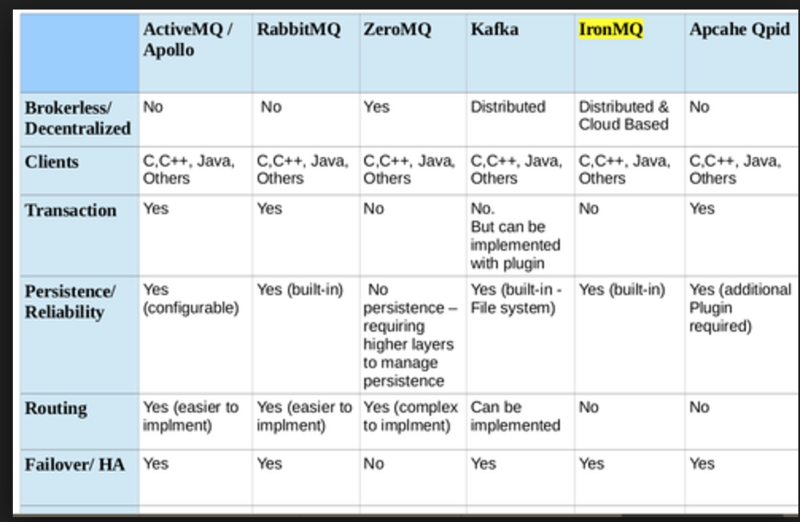

Slide 21
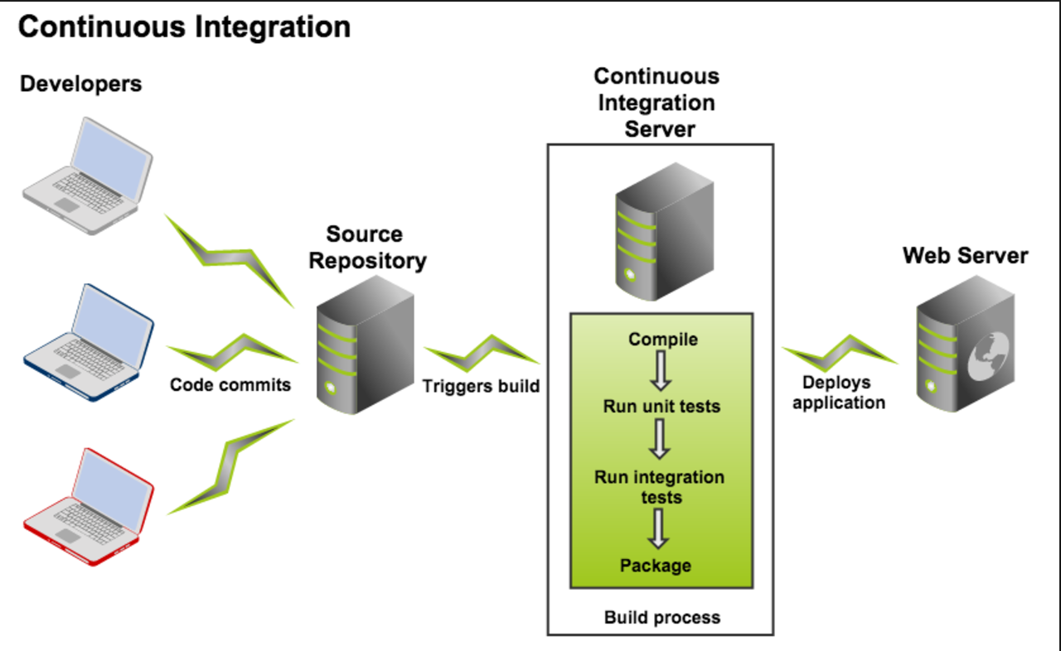

Slide 22
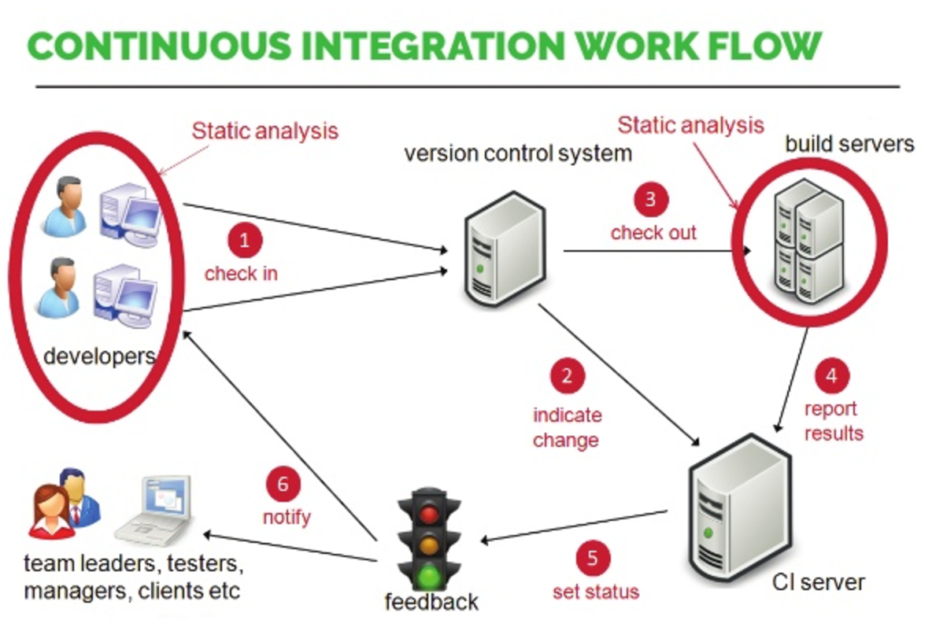

Slide 23
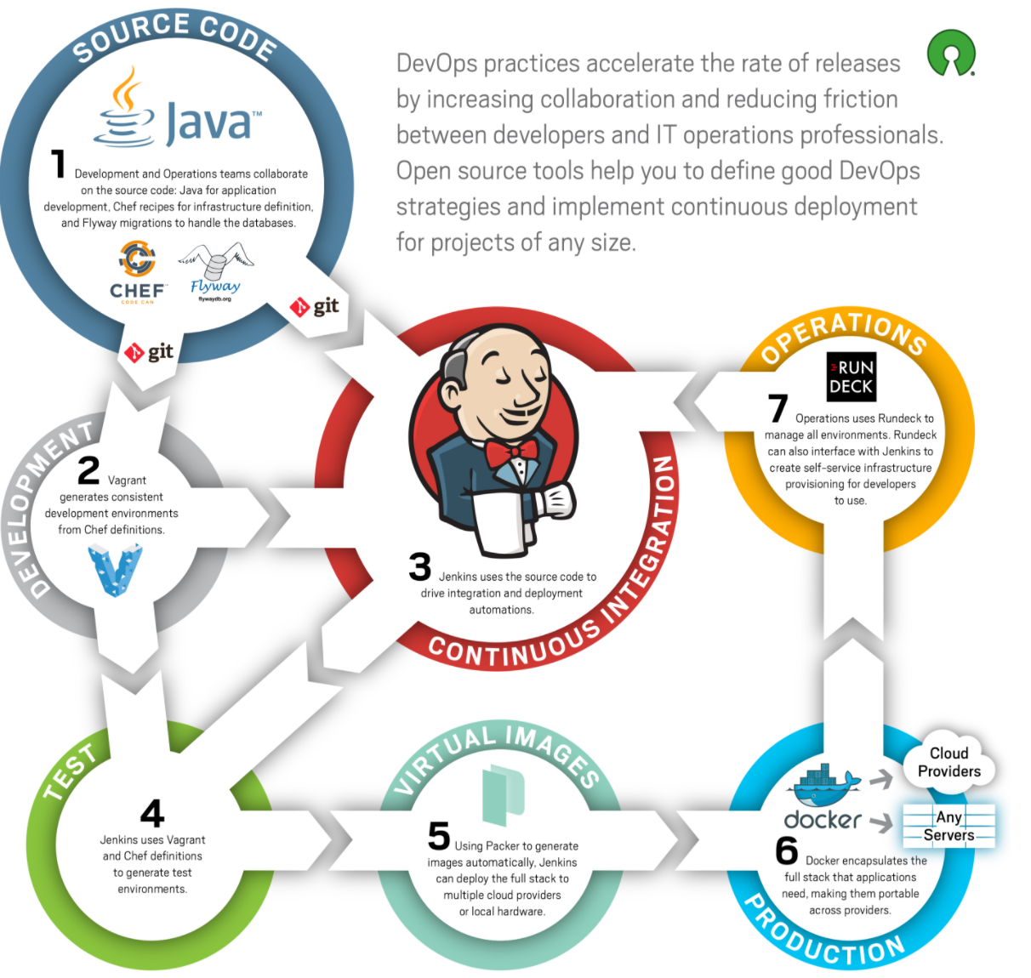

Slide 24
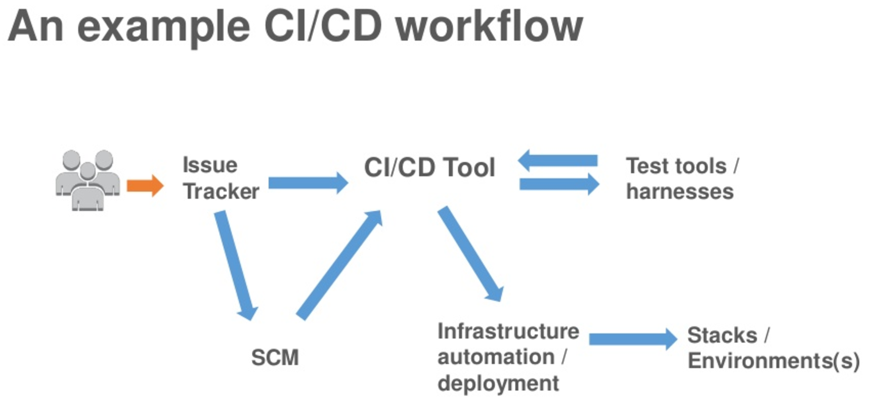

Slide 25
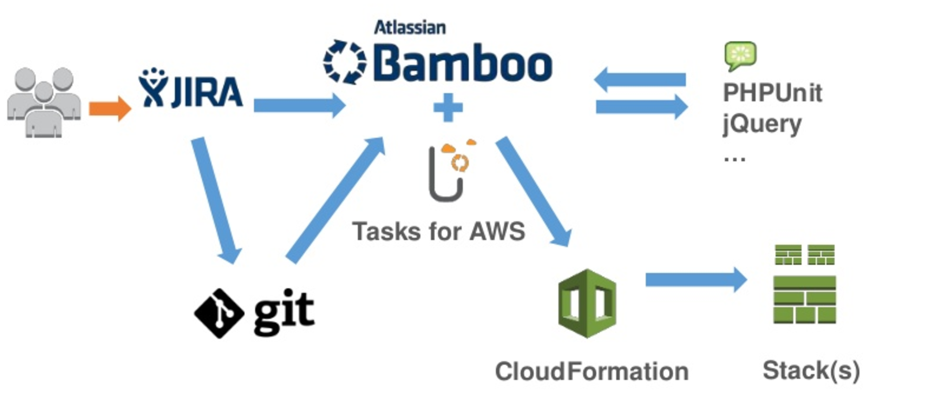
http://www.slideshare.net/AmazonWebServices/day-3-devops-culture-continuous-integration-continuous-deployment-on-the-aws-cloud

Slide 26
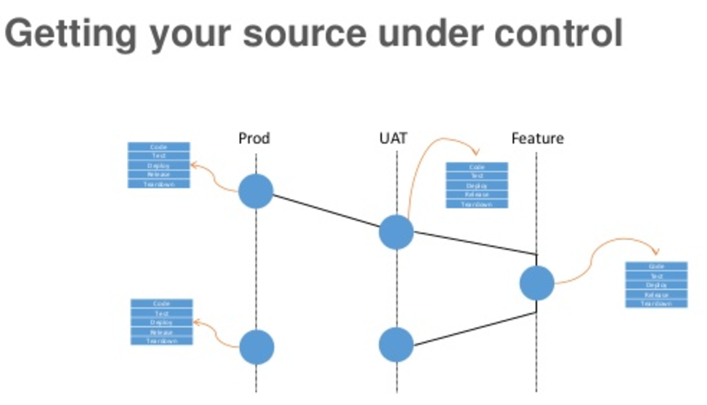
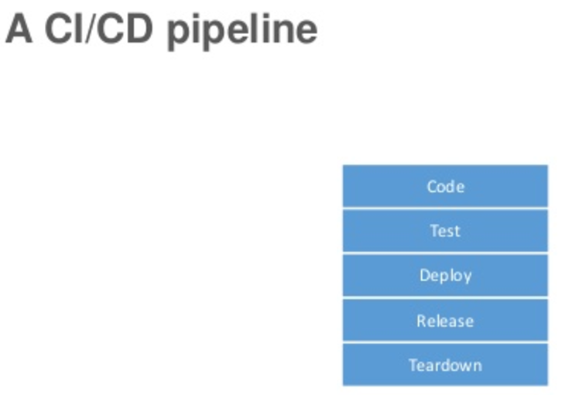

Slide 27
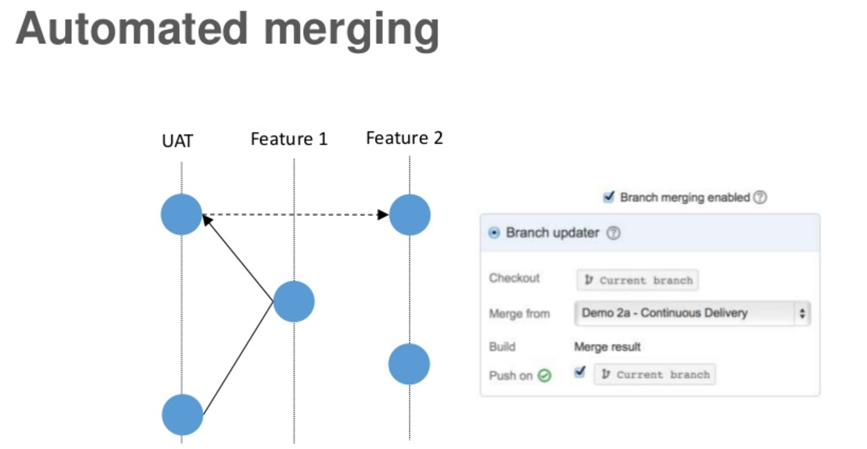

Slide 28
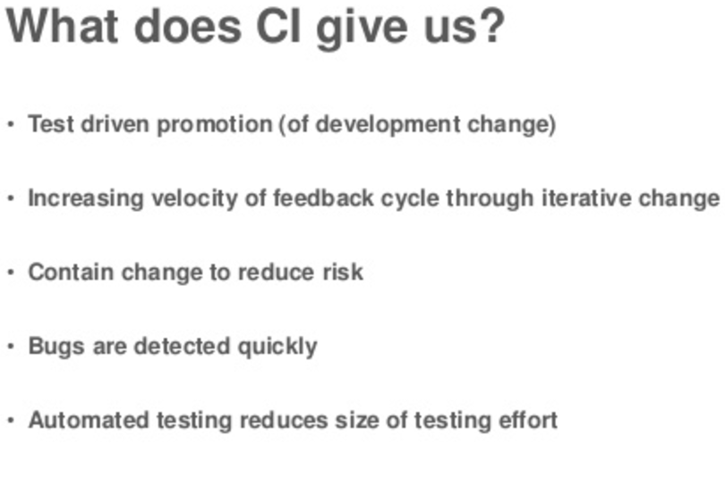
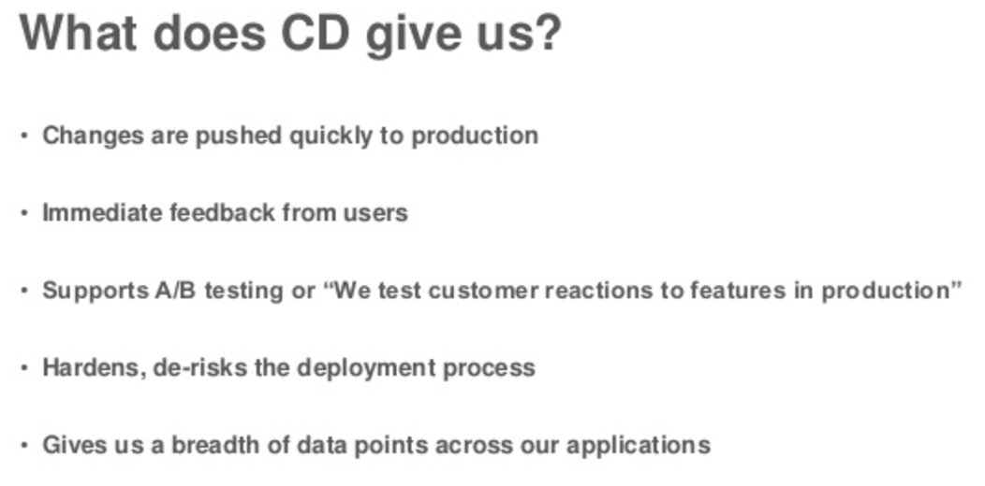

Slide 29
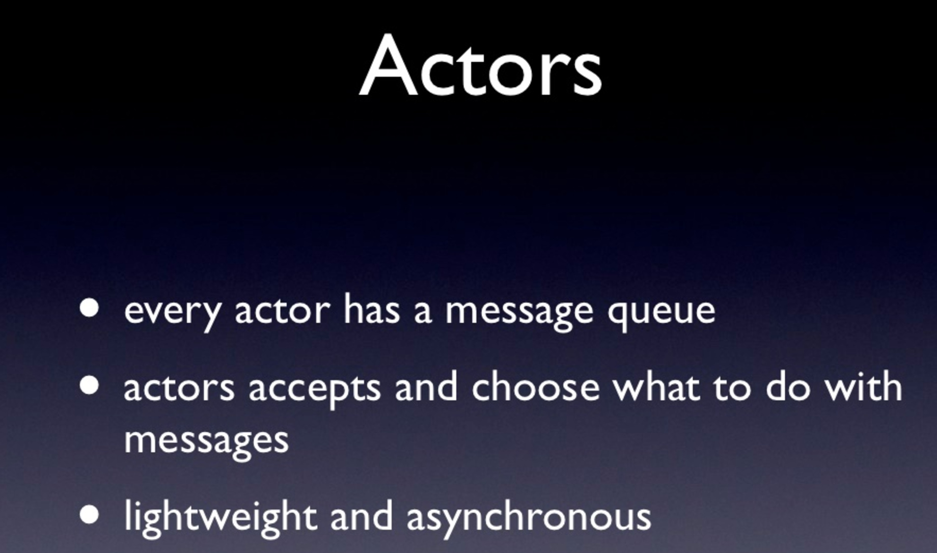

Slide 30
Git Pull / Push
Git status
Git add index.html or Git add . Or Git -A
Git commit –m “First commit” or “second commit”
Git Push
---------
Git checkout master ( check out master)
Git checkout contact-changes ( check out cc branch)
Git merge contact-changes ( Merge the changes )
Git branch –D contact-changes (Delete the branch )
------------------
Git push origin nbranch ( if you only git push then it will not push your branch)
--------
Git add .
git commit -am "Third Phase commit point”
Git push origin master or branch.
git push -u origin master
Difference between Java and scala.
http://javarevisited.blogspot.co.uk/2013/11/scala-vs-java-differences-similarities-books.html

Slide 31
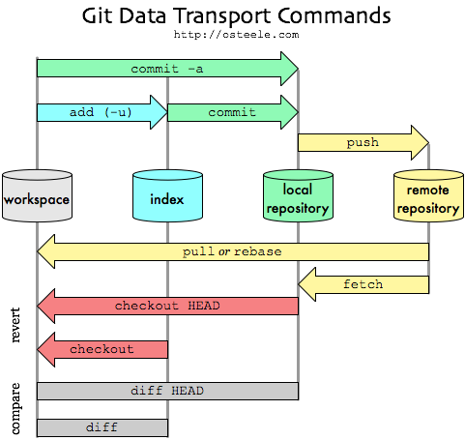

Slide 32
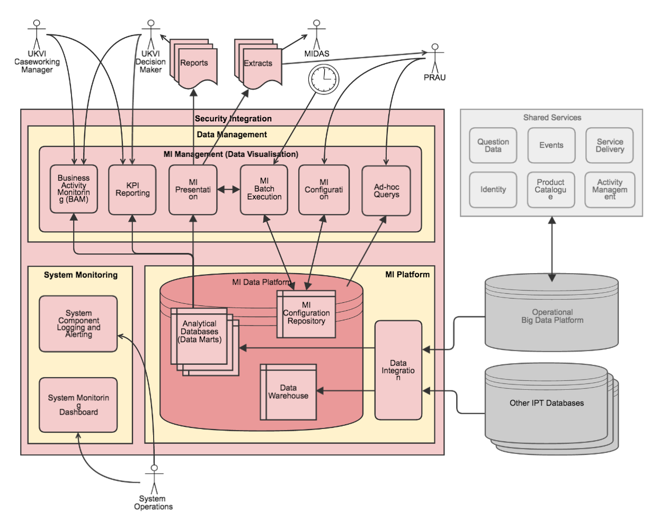

Slide 33
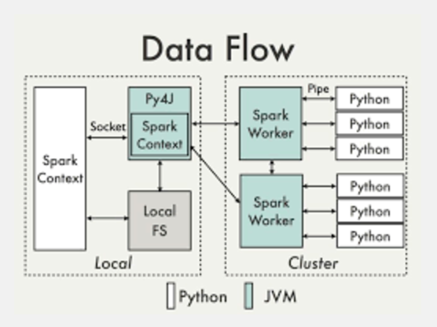
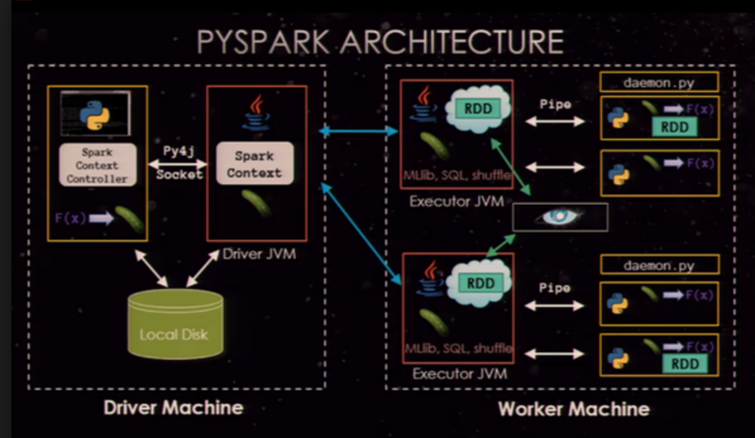

Slide 34
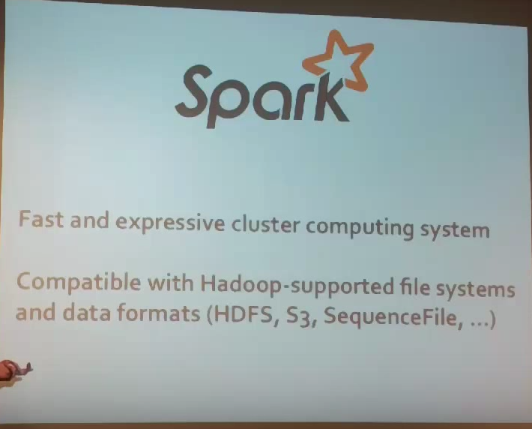
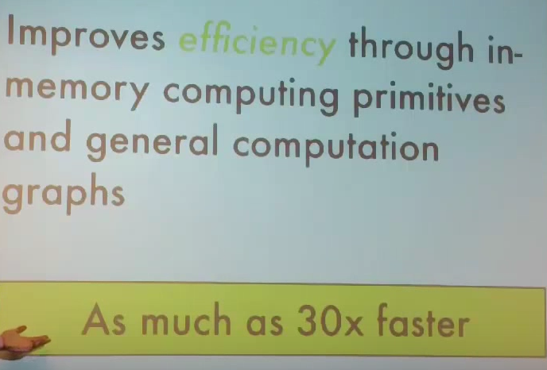
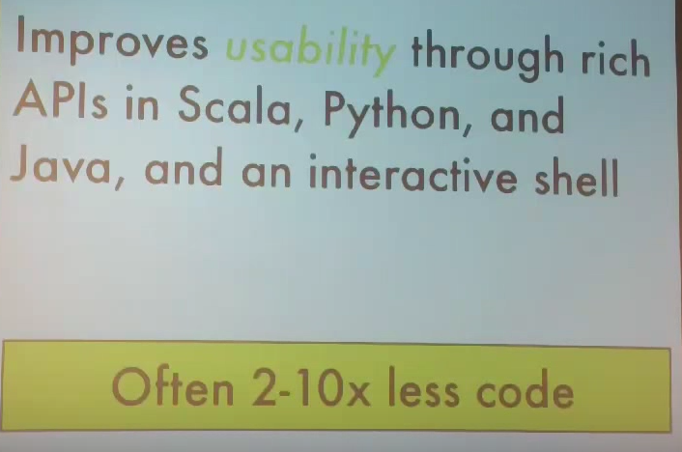
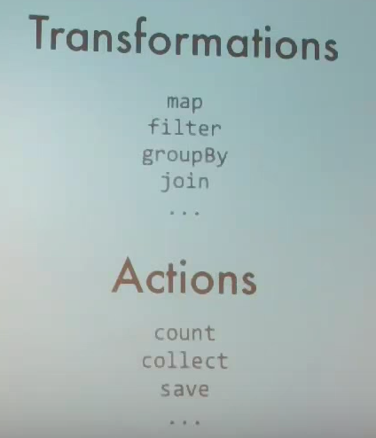
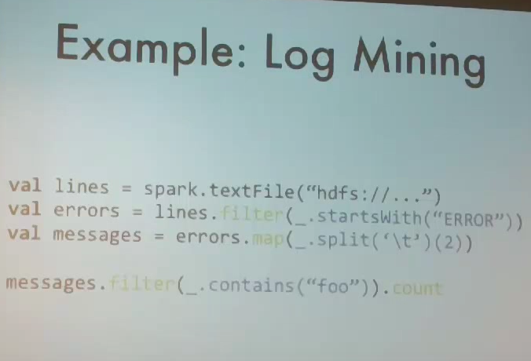
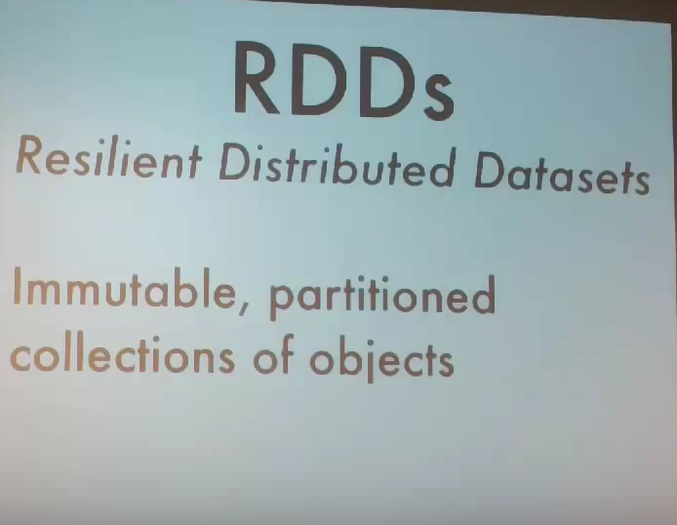
x

Slide 35
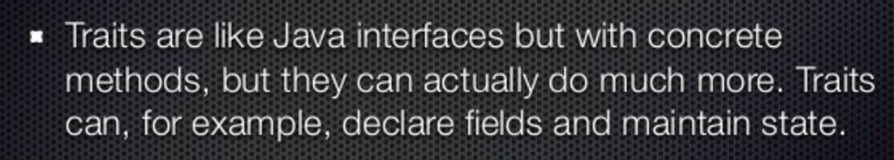
Scala Traits consists of method and field definitions that can be reused by mixing classes.
The class can mix any number of traits.
Traits define the objects by specifying the signature of the supported methods.
Traits are declared in the same way as class except that the keyword trait is used.

Slide 36
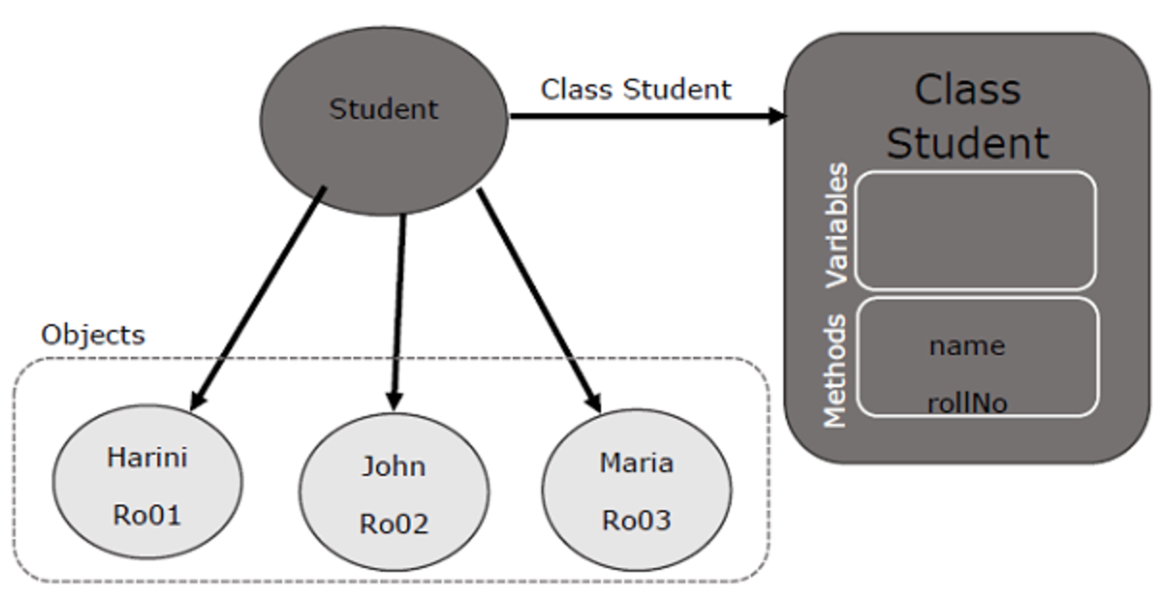
MI Data Architecture – Proposed Data Pipeline
Object
def main(args: Array[String])
Class
Variables
Method
Object − Objects have states and behaviors. An object is an instance of a class. Example − A dog has states - color, name, breed as well as behaviors - wagging, barking, and eating.
Methods − A method is basically a behavior. A class can contain many methods. It is in methods where the logics are written, data is manipulated and all the actions are executed. Logics, data manipulation, actions that need to be executed.
Class − A class can be defined as a template/blueprint that describes the behaviors/states that are related to the class.
Variables are nothing but reserved memory locations to store values.
This means that when you create a variable, you reserve some space in memory.

Slide 38
